Slide 1


European Tour Properties
2018 Support & Activities

Slide 2

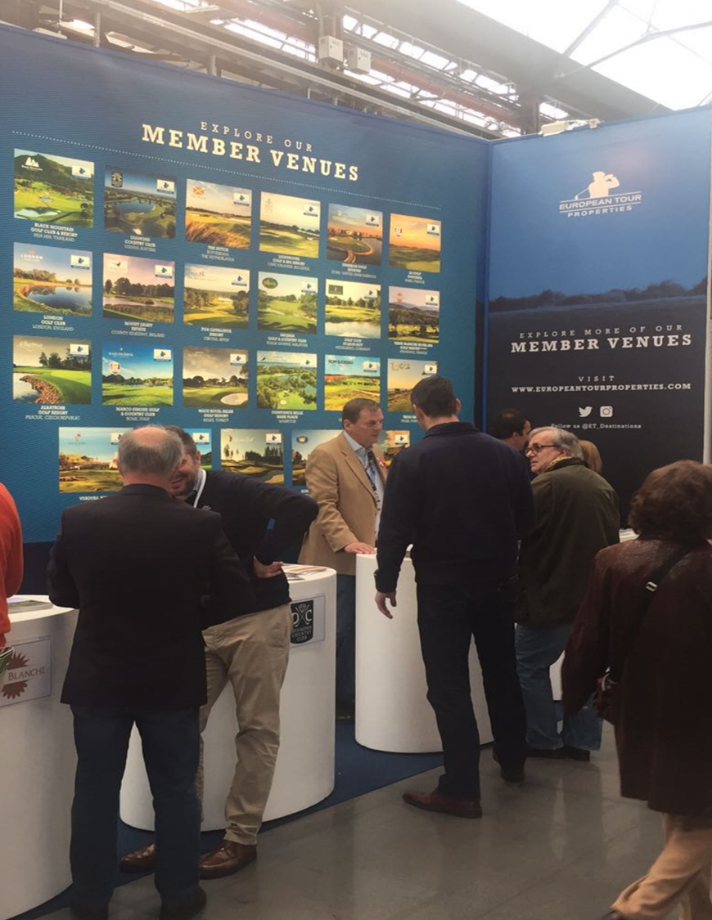


2018 Exhibitions
2018 Planned Activations
January 24th – 26th, PGA Merchandise Show
Orlando, Florida, USA
ET Properties attendance to identify industry trends, innovation and best practice. FAM Trip to major Golf Resort to be arranged for attendance with any ET Properties Network Personnel also attending the Show. http://www.pgashow.com/
February 23rd – 25th, Golftage München, Golf Show in southern Germany
Munich, Germany
ET Properties bespoke exhibition stand with opportunity for venues to participate at public golf show in Munich. Attended by approximately 20,000 visitors. https://www.golftage-muenchen.com/mainpage/home.html
April 22nd – 25th, Asian Golf Tourism Convention presented by IAGTO
Manila, Philippines
ET Properties will attend as a ‘sponsoring’ partner with opportunity for up to 10 venues to attend. More Info: http://www.iagto.com/agtc/event

Slide 3
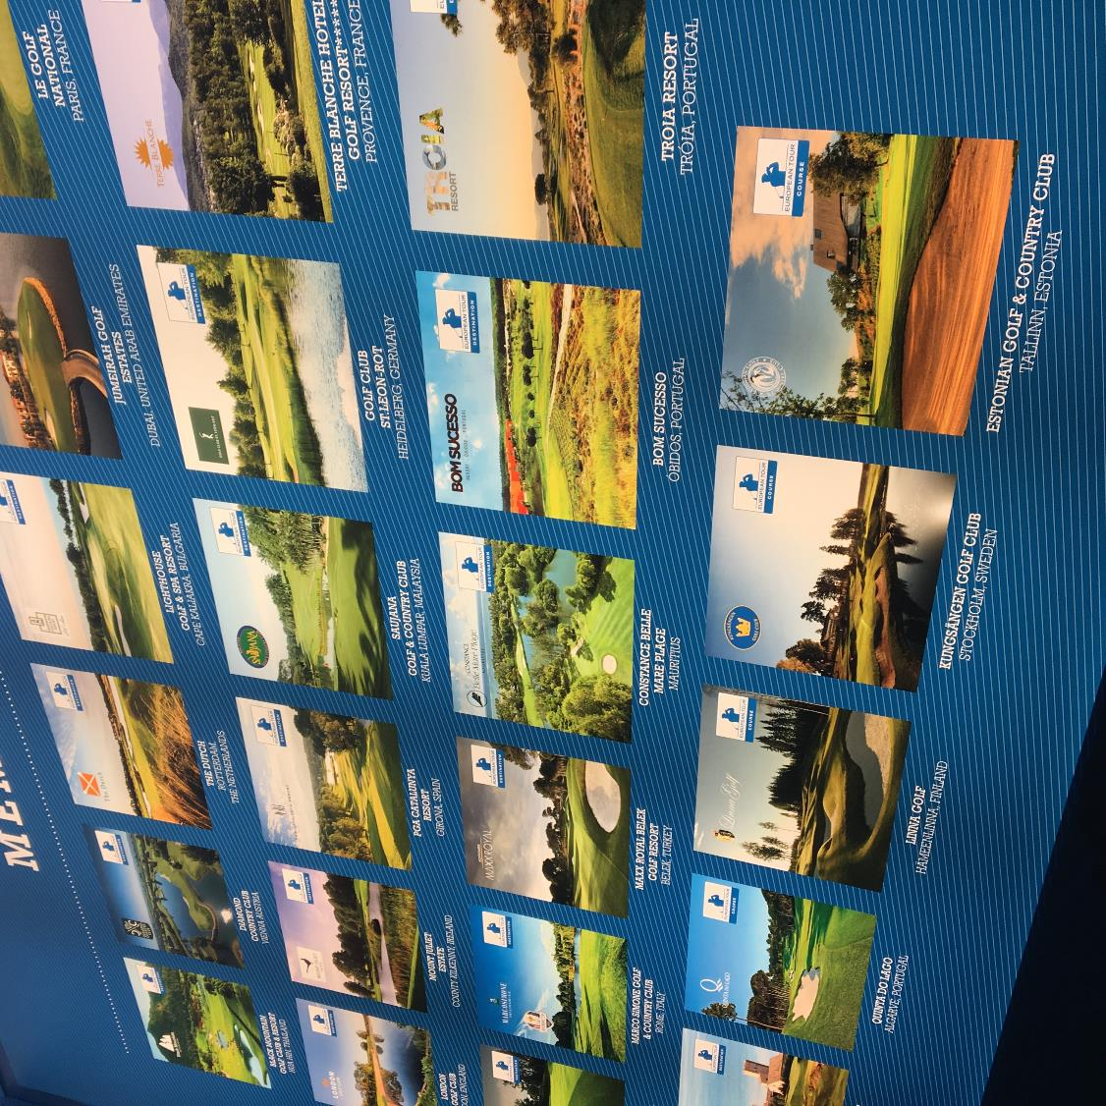

2018 Exhibitions
May 24th – 27th, BMW PGA Championship
Wentworth Club, Surrey, UK
Real estate focused exhibition stand in partnership with Real Estate Partner.
June 24th – 27th, North American Golf Tourism Convention presented by IAGTO
Oregon, USA
ET Properties will attend as a ‘sponsoring’ partner with opportunity for up to 5 venues to attend.
September 13th – 16th, KLM Open
The Dutch, The Netherlands
ET Properties bespoke exhibition stand, for data capture, no venue presence required.
October 15th – 18th, International Golf Travel Market
Slovenia
ET Properties bespoke exhibition stand with opportunity for up to 15 venue registered delegates to participate.

Slide 4




2018 Events
European Tour Properties Annual Conference, March 13th – 15th
London Golf Club, UK
3 day annual conference, with official dinner and workshops. ET Properties will pay for two nights hotel accommodation for one conference delegate per venue.
European Tour Properties Senior Classic, September 6th – 9th
Lighthouse Golf & Spa Resort, Bulgaria
Pro - am event where each ET Properties venue has the opportunity to enter one team of three, discounted accommodation rates also available.
European Tour Properties Invitational December 3rd – 6th
Jumeirah Golf Estates, Dubai
Annual golf event with reception, dinner, two rounds of ‘competition’ golf, gala dinner and prize giving. ET Properties venues to attend with clients, VIP guests or colleagues.

Slide 5






2018 Communications
2018 Conference Call
January conference call to venues previewing additional plans for the year.
E-newsletters 2018 x 5
E-newsletters sent to My European Tour database of approximately 230,000 registered emails requesting travel & real estate information, providing opportunity for current individual venue offers for golf rounds, golf packages and real estate.
Printed Newsletters 2018 x2
Two printed newsletters produced for use at events and within venues, offering an opportunity to effectively communicate longer term offers, news, development, tournament information and significant media items.
Business Newsletters x4
Sent to Industry focused database to promote venues, venue personnel and network to influencing audience.
ET Properties ‘Network News’
New platform for updating items of interest across the Network.
Media Drive Campaign – 12 month banner campaign across third-party golf sites
Additional to ongoing banner campaigns on ET.com site.

Slide 6
